Slide 1
ASP.NET Web API

Slide 2

You’re Probably Familiar With…
HTTP Fundamentals
  HTTP Messages
  URIs
  Verbs
  Status Codes
  Content Negotiation
Web API Fundamentals
  Routing
  Controllers and Actions
  HttpRequestMessage
  HttpResponseMessage
  Exceptions
  Validations

Slide 3
Beyond the Basics
Pipeline & Extensibility
Error Handling
Response Caching
Message Streaming
Security

Slide 4
ASP.NET Web API Pipeline
Host
Message Handlers
Controller
Model Bindings
Result Conversion
Action Method
Notes:
© 2014 Microsoft Corporation. All rights reserved. Microsoft, Windows, and other product names are or may be registered trademarks and/or trademarks in the U.S. and/or other countries. The information herein is for informational purposes only and represents the current view of Microsoft Corporation as of the date of this presentation. Because Microsoft must respond to changing market conditions, it should not be interpreted to be a commitment on the part of Microsoft, and Microsoft cannot guarantee the accuracy of any information provided after the date of this presentation. MICROSOFT MAKES NO WARRANTIES, EXPRESS, IMPLIED OR STATUTORY, AS TO THE INFORMATION IN THIS PRESENTATION.
27/06/19

Slide 5
ASP.NET Web API Pipeline
Host
Pipeline offers extensibility points
Replace default implementation
  Content negotiator
  Controller / Action selector
  Action invoker
Add your own implementation
  Authentication / Authorization
  Message formatters
  Exception handlers
Message Handlers
Controller
Model Bindings
Result Conversion
Action Method

Slide 6
Handling Requests and Responses
Delegating Handler
Host
HTTP Request Message
Message Handlers
HTTP Response Message
Message Handlers
x
Controller
Routing Dispatcher
Model Bindings
Result Conversion
Controller Dispatcher
Action Method
Notes:
© 2014 Microsoft Corporation. All rights reserved. Microsoft, Windows, and other product names are or may be registered trademarks and/or trademarks in the U.S. and/or other countries. The information herein is for informational purposes only and represents the current view of Microsoft Corporation as of the date of this presentation. Because Microsoft must respond to changing market conditions, it should not be interpreted to be a commitment on the part of Microsoft, and Microsoft cannot guarantee the accuracy of any information provided after the date of this presentation. MICROSOFT MAKES NO WARRANTIES, EXPRESS, IMPLIED OR STATUTORY, AS TO THE INFORMATION IN THIS PRESENTATION.
27/06/19

Slide 7
From Controller to Action
Controller
Host
HTTP Response Message
Authentication Filters
x
Message Handlers
x
Authorization Filters
Exception Filters
Controller
Model Bindings
Action Filters
Model Bindings
Result Conversion
Executing
Executed
Action Invoker
Exception
Action Method
Action Method

Slide 8
Attaching Components to the Pipeline
Attach globally
Per-controller
  Implement the Initialize method
  Configure formatters, parameter binding, and services
config.Formatters.Add(new MyCustomFormatter());
config.Services.Replace(typeof(IHttpActionSelector), new MyActionSelector());
class MyCustomControllerConfig : Attribute, IControllerConfiguration {…}

Slide 9
Error Handling - Fundamentals
If possible, return an HTTP 4xx (client error) response
By default, unhandled exceptions result in HTTP 500
Use exception filters instead of try/catch in actions
Exception filters won’t work for:
  Serialization errors
  Failing to initialize the controller (Ctor)
  Pre/Post controller exceptions

Slide 10
IExceptionLogger & IExceptionHandler
Cross-pipeline exception handling
Separate concerns for logging and handling exceptions
Can have multiple loggers, but only one response handler
Interfaces provide access to:
  Exception object
  Request & response
  Controller & action
  Indication to origin of exception

Slide 11
Message Handlers, Filters, and Friends
DEMO

Slide 12
Caching
HTTP caches can store copies of responses
Useful for reducing:
  Network traffic
  Server workload
  Call latency
Caches are a main factor for scalability on the web

Slide 13
Know Thy Headers - Caching
Cache-Control
  no-cache (Default): Response may be cached, but revalidated on next request
  no-store: Do not store a local copy
  max-age: Set TTL, in seconds
  private: Do not store in proxies
Expires
  Default value: -1 (expired)
  Specify date of expiration (UTC, up to a year from today)
  max-age takes precedence
While a resource is cached and hasn’t expired, no request is sent to the server

Slide 14
Controlling Cache Headers
ASP.NET’s Output Cache is supported in WebForms and MVC, but not in Web API
Manually add caching header to response
Best practice is to use an action filter
var cacheControl = new CacheControlHeaderValue();
cacheControl.MaxAge = TimeSpan.FromSeconds(300);
response.Headers.CacheControl = cacheControl;

Slide 15
Know Thy Headers - ETag
ETag (entity tag) contains a resource’s version
Can be a hash, timestamp, version number, GUID, …
First time:
Client caches response with ETag
Client
sends a request
Server adds ETag header to response

Slide 16
Know Thy Headers - ETag
ETag (entity tag) contains a resource’s version
Can be a hash, timestamp, version number, GUID, …
Subsequent calls:
Client caches response with ETag
Client sends a
request with ETag
Server compares ETag to resource’s version
Respond with the updated resource and Etag
Respond with HTTP 304 (Unmodified)
Response header is ETag
Request header is If-None-Match

Slide 17
Caching
DEMO

Slide 18
HTTP Streaming
The actual term is “HTTP chunked transfer”
Advantages
  Smaller memory allocation
  Message can be handled before completely received
  Enables the scenario of dynamically created content
Useful for
  File download/upload
  Live data feed (notifications, video streams, …)
  Slowly retrieved content

Slide 19
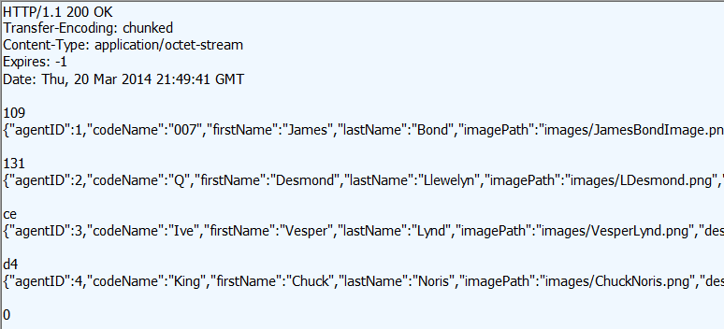
HTTP Chunked Transfer
Content-Length header is omitted
Chunk is sent as size + content
Chunk size can vary
Message ends when last chunk size is 0 (zero)

Slide 20

HTTP Chunking and Web API
Streamed requests
  Non-browser file upload
  Request.Content.ReadAsStreamAsync
  Browser-submitted file
  Request.Content.ReadAsMultipartAsync
Streamed responses
  Return an existing stream
  new StreamContent(inputStream)
  Return data of unknown size
  new PushStreamContent(contentWritingAction)
  (In the action, use Stream.Flush() to send a chunk)

Slide 21
Streaming (Chunking)
DEMO

Slide 22
Security Challenges
Authentication
Authorization
Secured channel
Input Validations
Error handling
Fundamentals
Already discussed

Slide 23
Authentication – External to the Pipeline
Authentication handled before reaching Web API
  IIS: Username & password / Windows identity / Client certificate
  ASP.NET: OWIN security middleware / Forms authentication
  Other: WIF / Custom IHttpModule
Identity and Principal are created for you
Also supported in self-hosting with Katana

Slide 24
Authentication – Part of the Pipeline
Authenticate requests using:
  Authentication filter
  Message handler (prior to Web API 2)
You create the Identity and Principal
Enables different authentication logic per controller
Support active authentication through a controller

Slide 25
Authorization
Use [Authorize] attribute to verify user is authenticated
Use the Users and Roles parameters to authorize access
[AllowAnonymous] attribute for anonymous actions in secured controllers
Create your own authorization rules by deriving from AuthorizationFilterAttribute

Slide 26
Authentication & Authorization
DEMO

Slide 27

Putting the Pieces Together
HTTP
Security
Extensibility
Error
Handling
Notes:
© 2014 Microsoft Corporation. All rights reserved. Microsoft, Windows, and other product names are or may be registered trademarks and/or trademarks in the U.S. and/or other countries. The information herein is for informational purposes only and represents the current view of Microsoft Corporation as of the date of this presentation. Because Microsoft must respond to changing market conditions, it should not be interpreted to be a commitment on the part of Microsoft, and Microsoft cannot guarantee the accuracy of any information provided after the date of this presentation. MICROSOFT MAKES NO WARRANTIES, EXPRESS, IMPLIED OR STATUTORY, AS TO THE INFORMATION IN THIS PRESENTATION.
27/06/19

Slide 28
Resources
ASP.NET Web API
  http://www.asp.net/web-api
  http://webapibloggers.com
Fiddler
  http://www.fiddler2.com
  http://www.vimeo.com/43659037
HTTP
  http://www.ietf.org/rfc/rfc2616.txt
Samples
  http://1drv.ms/1uQK4hb

Slide 29
Related content
Breakout Sessions
  DEV-B323 Building Web Apps Using ASP.NET and Visual Studio 2013
  DEV-B344 The Future of Microsoft .NET on the Server
Labs
  DEV-H201 ASP.NET Web API + Single Page Authorizations
Find Me Later At. . .
  TechExpo – Tuesday, 6:00pm-8:30pm
  TechExpo – Thursday, 4:00pm-5:00pm
  Ask the Experts – Thursday, 6:30pm-8:00pm
Notes:
© 2014 Microsoft Corporation. All rights reserved. Microsoft, Windows, and other product names are or may be registered trademarks and/or trademarks in the U.S. and/or other countries. The information herein is for informational purposes only and represents the current view of Microsoft Corporation as of the date of this presentation. Because Microsoft must respond to changing market conditions, it should not be interpreted to be a commitment on the part of Microsoft, and Microsoft cannot guarantee the accuracy of any information provided after the date of this presentation. MICROSOFT MAKES NO WARRANTIES, EXPRESS, IMPLIED OR STATUTORY, AS TO THE INFORMATION IN THIS PRESENTATION.
27/06/19

Slide 30
DEV Track Resources
http://www.visualstudio.com
http://blogs.msdn.com/b/developer-tools/
http://msdn.microsoft.com/vstudio
visualstudio
@visualstudio
visualstudio

Slide 31

Resources
Learning
Sessions on Demand
Microsoft Certification & Training Resources
http://channel9.msdn.com/Events/TechEd
www.microsoft.com/learning
TechNet
Developer Network
Resources for IT Professionals
http://microsoft.com/technet
http://developer.microsoft.com
Notes:
© 2014 Microsoft Corporation. All rights reserved. Microsoft, Windows, and other product names are or may be registered trademarks and/or trademarks in the U.S. and/or other countries. The information herein is for informational purposes only and represents the current view of Microsoft Corporation as of the date of this presentation. Because Microsoft must respond to changing market conditions, it should not be interpreted to be a commitment on the part of Microsoft, and Microsoft cannot guarantee the accuracy of any information provided after the date of this presentation. MICROSOFT MAKES NO WARRANTIES, EXPRESS, IMPLIED OR STATUTORY, AS TO THE INFORMATION IN THIS PRESENTATION.
27/06/19

Slide 32
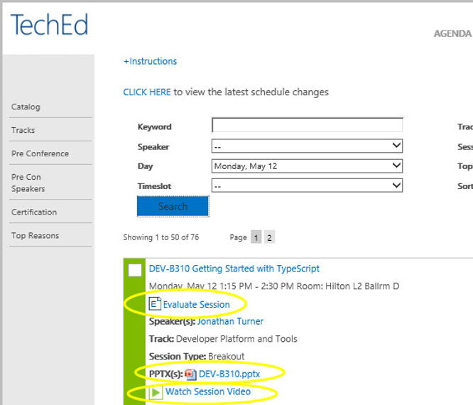
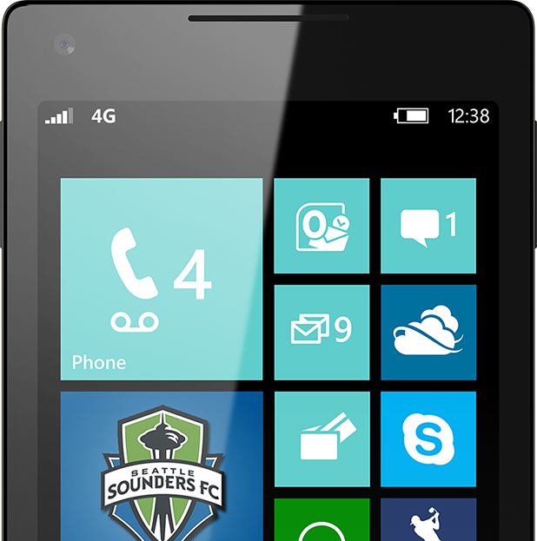
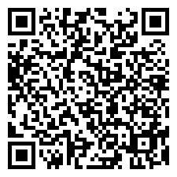
Please Complete An Evaluation Form
Your input is important!
TechEd Schedule Builder
CommNet station or PC
TechEd Mobile app
Phone or Tablet
QR code
Notes:
© 2014 Microsoft Corporation. All rights reserved. Microsoft, Windows, and other product names are or may be registered trademarks and/or trademarks in the U.S. and/or other countries. The information herein is for informational purposes only and represents the current view of Microsoft Corporation as of the date of this presentation. Because Microsoft must respond to changing market conditions, it should not be interpreted to be a commitment on the part of Microsoft, and Microsoft cannot guarantee the accuracy of any information provided after the date of this presentation. MICROSOFT MAKES NO WARRANTIES, EXPRESS, IMPLIED OR STATUTORY, AS TO THE INFORMATION IN THIS PRESENTATION.
27/06/19

Slide 33
Evaluate this session
Notes:
© 2014 Microsoft Corporation. All rights reserved. Microsoft, Windows, and other product names are or may be registered trademarks and/or trademarks in the U.S. and/or other countries. The information herein is for informational purposes only and represents the current view of Microsoft Corporation as of the date of this presentation. Because Microsoft must respond to changing market conditions, it should not be interpreted to be a commitment on the part of Microsoft, and Microsoft cannot guarantee the accuracy of any information provided after the date of this presentation. MICROSOFT MAKES NO WARRANTIES, EXPRESS, IMPLIED OR STATUTORY, AS TO THE INFORMATION IN THIS PRESENTATION.
27/06/19

Slide 34


© 2014 Microsoft Corporation. All rights reserved. Microsoft, Windows, and other product names are or may be registered trademarks and/or trademarks in the U.S. and/or other countries.
The information herein is for informational purposes only and represents the current view of Microsoft Corporation as of the date of this presentation. Because Microsoft must respond to changing market conditions, it should not be interpreted to be a commitment on the part of Microsoft, and Microsoft cannot guarantee the accuracy of any information provided after the date of this presentation. MICROSOFT MAKES NO WARRANTIES, EXPRESS, IMPLIED OR STATUTORY, AS TO THE INFORMATION IN THIS PRESENTATION.
Notes:
27/06/19
© 2014 Microsoft Corporation. All rights reserved. Microsoft, Windows, and other product names are or may be registered trademarks and/or trademarks in the U.S. and/or other countries. The information herein is for informational purposes only and represents the current view of Microsoft Corporation as of the date of this presentation. Because Microsoft must respond to changing market conditions, it should not be interpreted to be a commitment on the part of Microsoft, and Microsoft cannot guarantee the accuracy of any information provided after the date of this presentation. MICROSOFT MAKES NO WARRANTIES, EXPRESS, IMPLIED OR STATUTORY, AS TO THE INFORMATION IN THIS PRESENTATION.

